Slide 1




Pandemic Food Survey Analysis Presentation
By:- Shivangi Gupta

Slide 2
Agenda
Introduction
Problem Statement and Data Source
Objective
Methodology
Solution Architect Design
Conclusion

Slide 3
Introduction
In the throes of the 2020 pandemic, our study unveils a snapshot of survival strategies through the lens of food. This concise analysis focuses on key aspects—food quantity and quality, purchasing mediums, age vulnerabilities, generational food preferences—and aims to illuminate the unique ways individuals navigated the challenges of the global health crisis.
Study aims to understand how people coped with COVID-19 through food habits, exploring shifts in dietary patterns, food acquisition, vulnerabilities across age groups, and generational preferences, using a targeted survey and mixed research methods

Slide 4
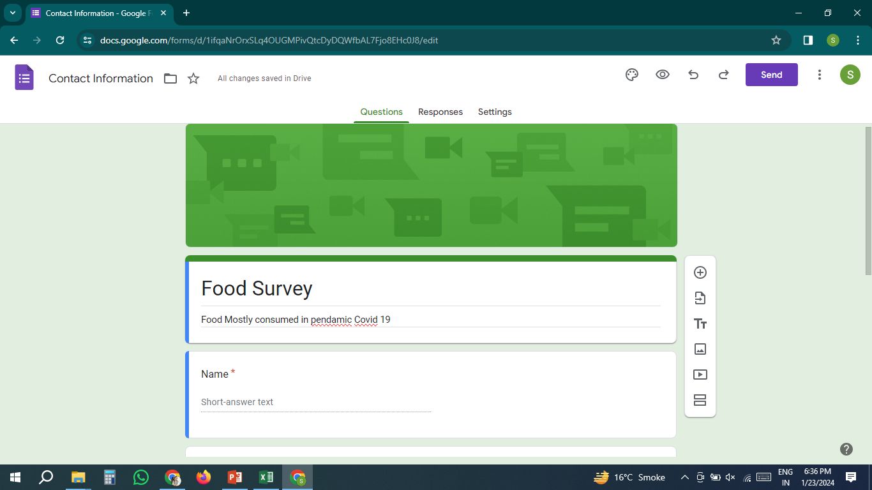
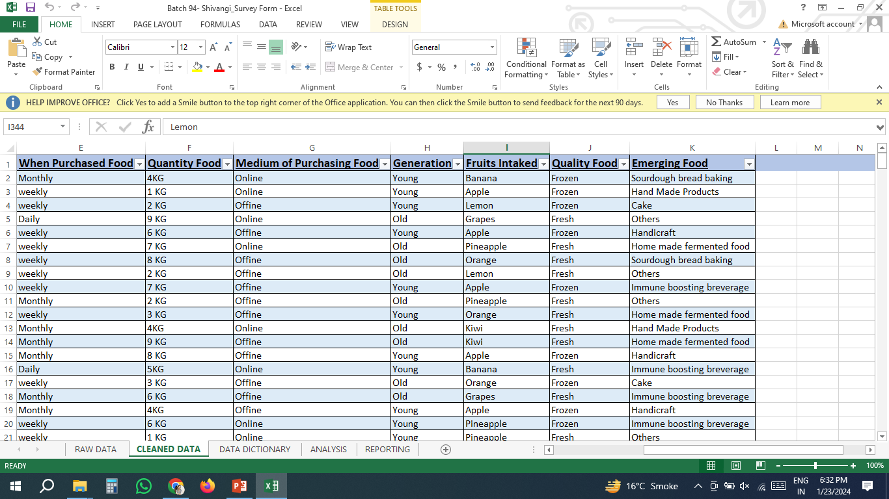
Problem Statement and Data Source
1
2
1. Made a google survey form on Food mostly consumed in Pendamic Covid 19 by people.
2. After sharing survey form globally I have received 350+ response on the food which people mostly consumed in pendamic covid 19 as a raw data

Slide 5
Objective
To understand how individuals coped with the challenges of the COVID-19 pandemic through their food choices, including shifts in dietary patterns, changes in the way food was acquired, and vulnerabilities across different age groups and generations.
To identify the adaptive strategies people employed to ensure sustenance and resilience during these unprecedented times, including the role of food in maintaining a sense of control and autonomy.

Slide 6
Methodology
Conducted a targeted food analysis survey encompassing diverse demographic groups, focusing on key parameters such as variations in food quantity and quality, the mediums through which individuals sourced their food during lockdowns, vulnerabilities observed across different age groups, and generational food preferences.
Employed a combination of quantitative and qualitative research methods, gathering data through structured surveys and in-depth interviews to gain nuanced insights into how individuals navigated the challenges of the pandemic through their food choices.

Slide 7
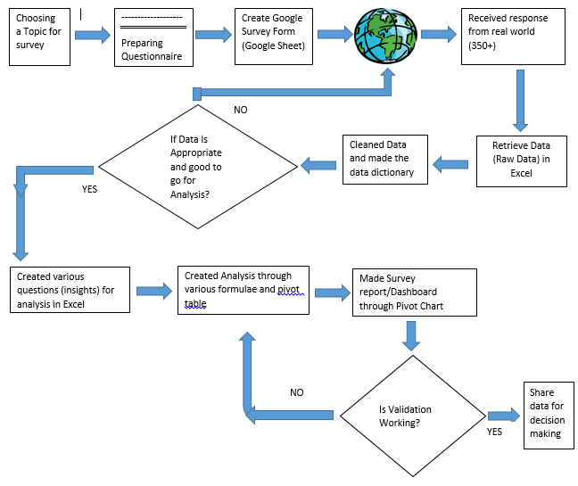
Solution Architect Design

Slide 8
Conclusion
In conclusion, our study provides a comprehensive understanding of how individuals coped with the challenges of the COVID-19 pandemic through their food choices. By examining shifts in dietary patterns, changes in food acquisition, vulnerabilities across age groups, and generational preferences, we gained valuable insights into the adaptive strategies people employed to ensure sustenance and resilience during these unprecedented times. Our findings highlight the importance of considering the interplay between food and society during times of crisis, and the need to develop sustainable and inclusive food systems that support the well-being of all individuals and communities which helps in data analysis.

Slide 9
Research & Analysis Presentation End
Thank You by Shivangi Gupta
Notes:
You can use this slide as your opening or closing slide. Should you choose to use it as a closing, make sure you review the main points of your presentation. One creative way to do that is by adding animations to the various graphics on a slide. This slide has 4 different graphics, and, when you view the slideshow, you will see that you can click to reveal the next graphic. Similarly, as you review the main topics in your presentation, you may want each point to show up when you are addressing that topic.
Add animation to images and graphics:
Select your image or graphic.
Click on the Animations tab.
Choose from the options. The animation for this slide is “Split”. The drop-down menu in the Animation section gives even more animations you can use.
If you have multiple graphics or images, you will see a number appear next to it that notes the order of the animations.
Note: You will want to choose the animations carefully. You do not want to make your audience dizzy from your presentation.

